Slide 1

Inception Meeting
Providing Consultancy and Program Management Services to Coal India Limited for Diversification and Value Addition
Coal India Limited
20 October 2020
Consulting

Slide 2

Agenda for Discussion
1.
Team
Introduction
2.
Project Context
3.
Project Plan & Timelines
4.
Support needed from CIL

Slide 3




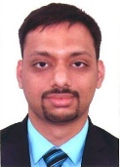

Here with you today
Deloitte Partner
Specialist – Coal & Major mineral
Finance Lead
Project Leader
Specialist – Thermal Power
Arindam Guha
Rajib Maitra
Sayantan Banerjee
Tushar Chakraborty
Partner,
Deloitte (India)
Director,
Deloitte (India)
Director,
Deloitte (India)
Associate Director,
Deloitte (India)
Arindam is a partner with Deloitte with more than 22 years of experience
Arindam is also EXCO member and Government & Public sector lead for Deloitte
More than 18 years of experience including 15 years’ experience in metals and mining sector
50+ engagements for governments, leading private sector and PSU companies. .
Over 21 years of experience in power sector consulting as well as coal power plant design/O&M
50+ engagements with governments, MFIs, thermal power gencos for Policy, B-plan, bid advisory, regulatory support
Over 14 years experience in the global mining & mineral industry.
He has also a First class mine manager’s certificate (Unrestricted/metalliferous) as certified by DGMS & RQP
Project Manager
Project Associate - Technical
Anirban Bandyopadhyay
Mainak Mukherjee
Manager,
Deloitte (India)
Senior Consultant,
Deloitte (India)
Over 12 years of experience including 6 years in coal power plant O&M and 6 years in power sector consulting covering conventional and RE generation
He is B.E. Power Engineering and MBA in Power Management
9+ years’ experience in exploration, resource planning, viability study for Coal, CBM, Iron Ore, Gold, etc. across India, Mozambique, Indonesia, PNG, Philippines, Nepal, Mauritania
He is M.Sc. In Applied Geology

Slide 4







































Deloitte is world’s largest professional services firm, with rich experience of executing similar mandates in India
Representative clients & projects
REVENUE
US$47.6 Bn
 | Strategy / market research / business plan | Due diligence/ feasibility studies | Regulatory support / Bid advisory | Strategic implementation
Coal / Major minerals / Metals
SCG/ C2C / CBM
Thermal power
Solar Energy
Mineral logistics
EBITDA Improvement / value addition
RANKED #1 GLOBALLY IN CONSULTING¹
SERVING BT 500 MINING AND METALS CLIENTS
9 of 13
MINING CENTERS OF EXCELLENCE
13
HEADCOUNT IN INDIA
50,000+
OFFICE ACROSS INDIA
14
PRESENCE IN COUNTRIES
150+
¹2019 ranking by Gartner based on Revenue and by IDC based on capability strategy
Notes:
Credentialise Deloitte with saying more than 125+ similar engagements executed across ministries, PSE and Private clients

Slide 5
Scope of work for the assignment
Diversification Areas
D1 - Surface coal gasification (SCG) based Coal-to-chemical Business
D2 - Utility-scale thermal power generation (Coal)
D3 - Solar power value chain (generation and backward integration)
D4 - Aluminium Smelting
D5 - Portfolio of non-fuel minerals through organic and inorganic growth
D6 - Coal Bed methane (CBM)
D7 - Mineral logistics
D8 - New Business Portfolio
Module 1: Market research and Sectoral assessment
Module 2: Market entry strategy, Business modelling and Feasibility study
Module 3: Bid process management and selection of Project implementation agency for operationalising the qualified sector strategies.
Module 4: Program evaluation and Monitoring
Value Addition Initiatives
V1 - EBIDTA Improvement Initiatives (Quick Wins)
V2 - Shareholder value enhancement
V3 - Any set of activities / process (physical / financial), in any domain, that adds value to the Company based on emerging business environment / market dynamics
Module 1: Identification of Value Addition Activity and Impact Assessment
Module 2: Framing of Implementation Plan
Module 3: Bid process management and selection of Project implementation agency for operationalising the qualified Value Addition Process / Activities.
Module 4: Program evaluation and Monitoring

Slide 6
Overall Work Plan
Draft report
Selection of PIA
 | 1 | 2 | 3 | 4 | 5 | 6 | 7 | 8 | 9 | 10 | 11 | 12 | 13 | 14 | 15 | 16 | 17 | 18 | 19 | 20 | 21 | 22 | 23 | 24
Phase 1
Module 1: Market Research and Sectoral Assessment For Activities D1, D2
For Activities D3, D4 & V1
Module 2: Market Entry Strategy, Business Modelling and Feasibility Study For Activities D1, D2, D3, D4 & V1 (after CIL concurrence on Module 1 Final Report)
Phase 2
Module 1: Market Research and Sectoral Assessment For Activities D5, D6, D7
For Activities D8, V2 & V3
Module 2: Market Entry Strategy, Business Modelling and Feasibility Study For Activities D5, D6, D7, D8, V2 & V3 (after CIL concurrence on Module 1 Final Report)
In case CIL decides to proceed for Module 3 and 4 based on the outcomes of Module 1 and 2
Module 3: Bid Process Management for selecting PIA
Module 4: Program Evaluation and Monitoring
Key Project modules
Months
Kick-Off
Phase I closure
Phase II closure
Module 3

Slide 7
Key Activities and Outcome in the first 12 weeks
Areas
Activities
Outcome
Team mobilization
Interactions with stakeholders, surveys
Data collection from CIL based on previous assignments
Prioritise key diversification & value addition initiatives
Initiatives prioritization
Database for initiatives
Framework for market research report
Internal Assessment
Assessment of initiatives based on available information
Study of trends for each initiatives including trade dynamics
Technology and Regulatory trend analysis
Market assessment and projections
Market assessment report for prioritized initiatives
External Assessment
Conduct opportunity diagnostic
Identification and assessment of opportunities for quick win
Assessment of opportunities for financial returns
Preparatory activities (business case) for strategic options
List of quick win initiatives
Business case including potential EBITDA impact for such initiatives
Opportunities

Slide 8




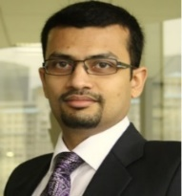



Team structure
CIL management personnel
Steering committee
To be Defined
CIL
Rakesh Surana
Engagement Partner & SME
Shridhar Kamath
Partner & Specialist – EBITDA improvement
Rajib Maitra
Coal & Major Mineral
Sanjay Sah
Chemical
Sayantan Banerjee
Thermal Power
CIL professionals
Leadership Team
Peejush Naidu
Mineral Logistics
Amitabh Saha
Solar Energy
Specialists
To be Defined
CIL
Tushar Chakraborty
Project Leader
Provide insight, coach and challenge project team on relevant matters and during workshop, critical interactions
Visit based on prior approval of CIL management as per agreed rate
CIL Project Manager
Project Management and operating team
Representatives from CIL
Coal Videsh 1
Coal Videsh 2
Technical
CMD office
Access to pool of consultants (need basis)
Anirban Bandhopadhyay
Project Manager
Surbhi Patni
Project Associate - Finance
Mainak Mukherjee
Project Associate - Technical
Provide inputs as well as coordinates leadership interactions as needed to understand constraints, capabilities & capacities
CIL
Deloitte

Slide 9
Our governance structure
Type of review | Proposed date | Duration | Mode | Location | Agenda | CIL participants | DTTILLP Participants
Fortnightly status update meetings | Friday | 30 minutes | Physical | CIL HO, Kolkata | Discussion on progress Activities and deliverables during last two weeks Activities and deliverables planned for the coming week Key decisions / support required to manage progress as per targets | CIL SPOC from Coal Videsh team | Project Manager Associates (Technical & Finance)
Monthly update meetings | Friday | 1-2 Hours | Physical | CIL HO, Kolkata | Provide guidance and advise on the deliverables Provide feedback / decisions on the key observations Oversee the quality and progress of the engagement | Director(T) GM (CV) Other officials | Project Leader Project Manager Associates (Technical & Finance)
Steering Committee meetings | Once in 2 months | 1 hour | Physical/ Virtual | CIL HO, Kolkata | Escalate any critical issue / limitations observed during the course of assignment | CMD Directors CIL senior officials | Deloitte senior officials (need basis) Project Leader Project Manager

Slide 10
Support needed from CIL
Infrastructure and Data Requirements
Working space for 4 - 5 team members along with locker
Telephone, internet (Wi-Fi) connectivity
Printer availability and connectivity
Projector availability
Sharing of relevant data requested as given in the Information Requirement List - reports, studies, organogram, plans, financials etc.
Communication/ Feedback Requirements
Identification of CIL single point of contact (SPOC) to facilitate necessary communication with other stakeholders.
Timely coordination of meetings with different CIL internal stakeholders as needed
Participation and feedback from senior CIL stakeholders in Steercom and Workshop meetings
Next steps
Completion of formalities related to Performance Bank Guarantee and Contract execution after requisite internal clearances
Mobilization of the site team members
Formal kick-off meeting after one week of mobilization

Slide 11
End of Presentation.
Deloitte refers to one or more of Deloitte Touche Tohmatsu Limited, a UK private company limited by guarantee (“DTTL”), its network of member firms, and their related entities. DTTL and each of its member firms are legally separate and independent entities. DTTL (also referred to as “Deloitte Global”) does not provide services to clients. Please see www.deloitte.com/about for a more detailed description of DTTL and its member firms.
This material has been prepared by Deloitte Touche Tohmatsu India LLP (“DTTILLP”), a member of Deloitte Touche Tohmatsu Limited, on a specific request from you and contains proprietary and confidential information. This material may contain information sourced from publicly available information or other third party sources. DTTILLP does not independently verify any such sources and is not responsible for any loss whatsoever caused due to reliance placed on information sourced from such sources. The information contained in this material is intended solely for you. Any disclosure, copying or further distribution of this material or its contents is strictly prohibited.
Nothing in this material creates any contractual relationship between DTTILLP and you. Any mutually binding legal obligations or rights may only be created between you and DTTILLP upon execution of a legally binding contract. By using this material and any information contained in it, the user accepts this entire notice and terms of use.
©2020 Deloitte Touche Tohmatsu India LLP. Member of Deloitte Touche Tohmatsu Limited
Deloitte Touche Tohmatsu India Private Limited (U74140MH199 5PTC093339), a private company limited by shares, was converted into Deloitte Touche Tohmatsu India LLP, a limited liability partnership (LLP Identification No. AAE-8458),with effect from October 1, 2015.

Slide 12
ANNEXURES

Slide 13




Our proposed team to execute this assignment
ARINDAM GUHA
PARTNER, GOVERNMENT & PUBLIC SECTOR LEAD
EXCO member
PROGRAM LEADERSHIP
GLOBAL EXPERTS
RAKESH SURANA
PARTNER,
MINING & METALS LEADER
SPECIALISTS
Bringing together the best of Deloitte Leadership and Teams
SITE TEAM
MAINAK MUKHERJEE
SENIOR CONSULTANT
Project Associate-Technical
EXPERIENCE
24+
DEBASISH MISHRA
PARTNER,
ENERGY & RESOURCES LEADER
22+
9+
23+
ANDREW SWART
PARTNER,
METALS & MINING SME-GLOBAL
Global Mining SME
SURBHI PATNI
SENIOR CONSULTANT
Project Associate- Finance
6+
25+
12+
27+
ANIRBAN BANDYOPADHYAY
MANAGER
Project Manager
14+
22+
TOM ALDRED
PARTNER
Global SME - Chemical/ Process Industry
17+
22+
22+
20+
18+
TUSHAR CHAKRABORTY
ASSOCIATE DIRECTOR
Project Leader
SHRIDHAR KAMATH
PARTNER
Specialist- EBITDA improvement
AMITABH SAHA
DIRECTOR
Specialist- Solar Energy
SANJAY SAH
PARTNER
Specialist- Chemical
RAJIB MAITRA
DIRECTOR
Specialist-Coal & Major Mineral
SAYANTAN BANERJEE
DIRECTOR
Specialist- Thermal Power
PEEYUSH NAIDU
PARTNER
Specialist- logistics
Available today

Slide 14



Overall approach covering diversification and value addition initiatives
1
Identification of the Sectoral Scenarios of Major Diversification Areas
2
Derive the Strategy to Penetrate
3
Onboarding of Project Implementation Agencies (PIA)
4
Program Monitoring and Evaluation
Identification of the market scenario, Opportunity and Challenges
Implication led research on underlying issues and interventions
Hypotheses building and mapping them to suitable action items
Design components of project management and PMO support
Draft preliminary hypotheses on the shortlisted diversification areas
Conduct deep industry analysis to prioritize areas and articulate areas of play, how to play and strategic relevance
Prioritization based on CIL’s competencies and organizational gaps, mission and vision
Identify plausible interventions and support required in policy level, organization level and stakeholder level
Analyze interventions to policies, manpower in-force and list considerations for framing implementation strategy
Risk Assessment and Mitigation Plan
Build target operating model and operationalization plan for PIA;s for implementing strategic goals
Map them to bidding documents
Bid process management support for onboarding the PIAs
Develop action plan for PIAs
Mapping of a Project Management Framework with teaming and reporting structure
Develop PEMO tool
Issue Management and Mitigation Support
Project timeline and cost evaluation and monitoring
Value Addition Initiatives
EBIDTA Improvement
Shareholder Value Enhancement
Process Intervention assessment for emerging markets

Slide 15
Module 1: Market Research and Sectoral Assessment
Key Focus areas of the target Areas and Markets
Key Principles for Areas of Play
Illustrative Market Assessment
Developing the Action Items
Aligned with CIL’s mission and vision?
Meeting Diversification goals?
Positional advantages?
Matching Core competency?
Market Assessment Check-List
Organizational Competency
Macro Scenario
Financial
Outlook
Strategic Relevance Assessment
Opportunities and Challenges
Demand Supply scenario
PRESTL Analysis
Value Chain Assessment
Key Players and Competition
Overall contribution in economy
Financial condition
Raw Material and Value Chain analysis
Key Risks
Margin assessment
Assessment of the financials of the key players
Profitability assessment
Cost of raw material
Cost optimization initiatives
Investment flows in the market
Projected growth
Planned capacity addition
Plan to mitigate demand-supply gap
Government policy trajectory for the sector
Shareholders sentiment towards the sector
Risk
Skill-benchmarking Requirement
Structural interventions required?
Process Changes?
Competition
Projections and Outlook
Illustrative
Market Scenario
Market Strategies
IT & Digital
Location and High-Level feasibility
Existing business model
Advantages and disadvantages of current models
Innovative models
Case studies and learnings
Digital penetration Level
Land Availability
R&R requirement
Connectivity
Basic Infrastructure availability
Gaps in the process
Strategic interventions required
Prioritize the areas of play
Environment, Health & Safety
EHS related concerns
Identification of Potential areas of play
Assessment of As-Is Scenario for competency
Identification of Key Areas for Developing Strategy

Slide 16
Module 2: Developing Strategies
Module 2: Developing the strategies for market penetration of the shortlisted models
Commercial market
Market attractiveness
Competitive position
Strategic position
Organizational Transformation
Organizational Competency
Scenarios and options
Insight
Chosen
strategy
Infrastructure Requirement Analysis
Strategic
issues
Develop Business Models
Implementation Plan
Financial position
Economic profitability
Growth
Capital market

Slide 17

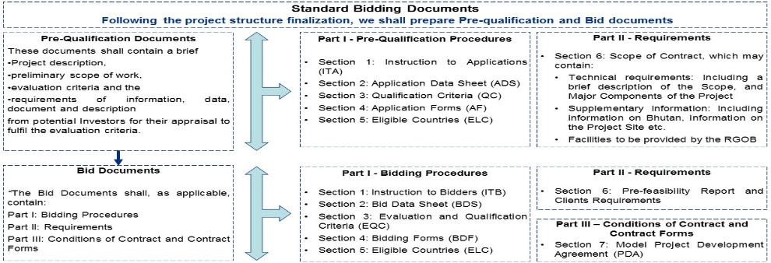
Module 3: Preparation of RFP for Selection of PIA
Once CIL Management decides to go ahead with the diversification plan, Deloitte will assist CIL in drafting the RFP for selection of PIA
Deliverable
The first step in the ERP Implementation is the preparation of an RFP for selection of ERP package and Implementation partner
Illustrative areas to be covered in the RFP for PIA Selection
Staged delivery schedule
Mode of bidding (limited/open).
Procurement methods (Quality cost basis, Lowest bid, highest technical, etc.)
Evaluation Criteria
Definition of Performance Parameters and Performance Levels to be met by the PIA
Definition of Scope of Work and Deliverables with High Level Project Plan
Process Description and Functional Requirement Specifications categorized as Critical, Essential, Desirable
Capacity Development Plan
Post implementation support requirements at locations with service level specifications
Performance Guarantee, Warranty requirements (as needed)
Nature of system documentation required (operational, system and user level)
General and Special terms and conditions governing the RFP
Sample Bidding Documents

Slide 18
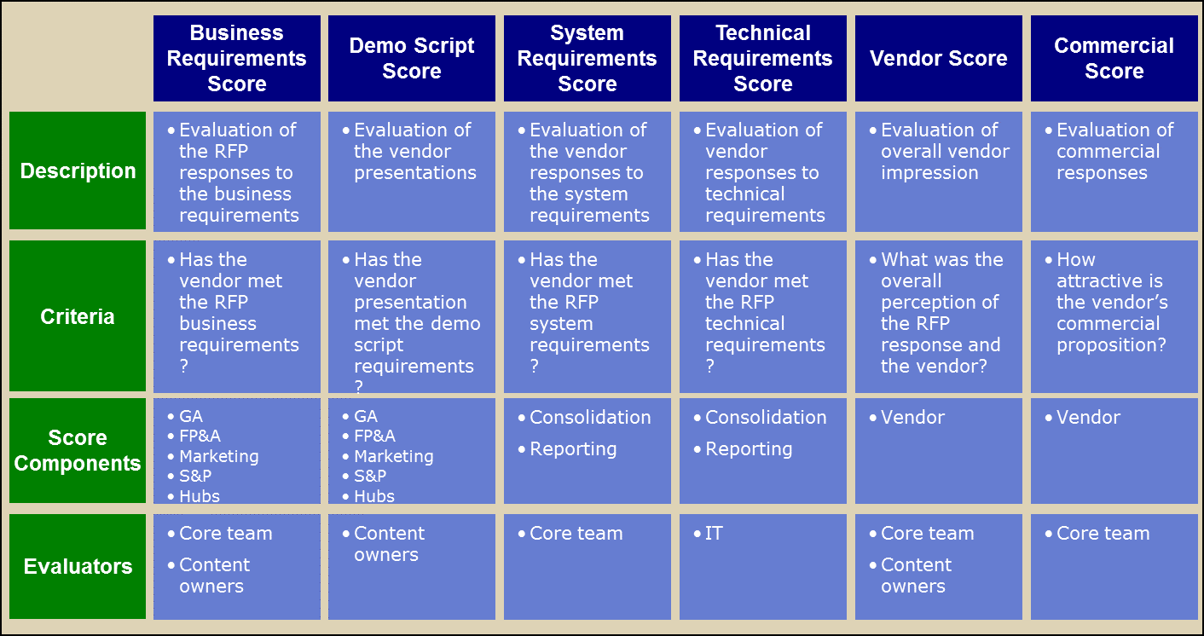
Module 3: Preparation of RFP for Selection of PIA
Based on developed draft biddable RFP, Deloitte will assist CIL in selection of Project Implementation Agency (ies) (PIA) based on a defined process.
Evaluation criteria in RFP
Vendor Demos
Review demos & ranking
Final evaluation of solutions
The second step in the ERP Implementation is the evaluation of the bids received from Project Implementation agencies
Review the RFPs, working towards a scoring consensus between evaluators
Complete relevant sections of the scoring matrix
Formulate questions during review
Consolidate questions and submit to vendors
Vendors present their solution using the demo scripts
Vendors respond to the additional RFP questions
Review vendor demos and achieve scoring consensus
Complete evaluation matrix
Review preliminary ranking calculated by scoring matrix
Consider composite solutions
Prepare shortlist and request site visits
Finalise PIA evaluation
Prepare Business Case for the vendor selection and present the same to the management
EVALUATION SCORE MATRIX
Illustrative

Slide 19
Module 4: Four pronged approach to drive program execution and ensure timely implementation
Overall Program Management
Governance, risk & milestone tracking
Policy change log management
Dashboard to monitor KPI’s & plan Corrective actions
1
2
3
3
4
Communication & feedback management
1
Governance, Monitoring & Tracking mechanism
Governance structure: Set up the Program hierarchy & decision making
Key Risks : Critical risks are highlighted to leadership to gain alignment on mitigation measures
Critical Milestones: Document all critical milestones indicate progress towards each
2
Policy change log management
Centralized change log tracker :Logs to capture changes suggested by stakeholders in various meetings
Prioritization criteria: Criteria to prioritize the various inputs for action to facilitate the agreement
Version Control: Version control of policy to facilitate the work allocation and consolidation
3
Dashboard to monitor KPI’s & plan Corrective actions
Program KPIs : Setup measures of success and dashboard view of project status
Roll-up Summary Dashboards : Provides summary view of all KPIs, activities, work-stream status, interactions planned versus actual for each work-stream.
4
Communication & feedback Management
Policy Communication Plan : High level plan to communicate the changes and progress of changes to internal and external stakeholders
Communication Content Approval Process : Structured process which will enable the communication content for communication of information

Slide 20














Module 4: Setting up of the PMO & Implementation Monitoring Framework
Illustrative Approach
1
1
The scope is defined, realistic and actively monitored
8
Risk Management
Scope Management
2
Deliverables and approval process are defined and clear
2
3
Quality standards are defined and monitored
Cost Management
Deliverables Management
Consistency and Delivery Excellence
4
Work is planned and tracked, and critical path is monitored
7
3
5
Team is competent, motivated and exemplary
Communication Management
Quality Management
6
All stakeholders are involved
6
7
Costs are monitored and expected gains have been measured
Human Resource Management
Time Management
4
5
8
Risks are anticipated and mitigation actions are triggered on time
Documentation during program management
Action Log
Monthly review
Risk Log
Timeline and Financial Log
Outcome analysis reports
Detailed list of activities to be actioned (current week and next week) with completion dates and responsibility owners to be published every week before Friday EOD
Review of the project in presence of key stake holders – CIL Management, and project management team and send monthly review report
Identify the risk items which have the potential to hamper the project outcomes with action plan to mitigate the same – to be highlighted to CIL project team and respective Vendor
Monitor timely implementation and prepare implementation status report
Assessment of project finance, costing and financial status
Prepare the outcome analysis report consisting of the detailed assessment of the tangible and intangible benefits achieved by CIL from each diversification initiative

Slide 21
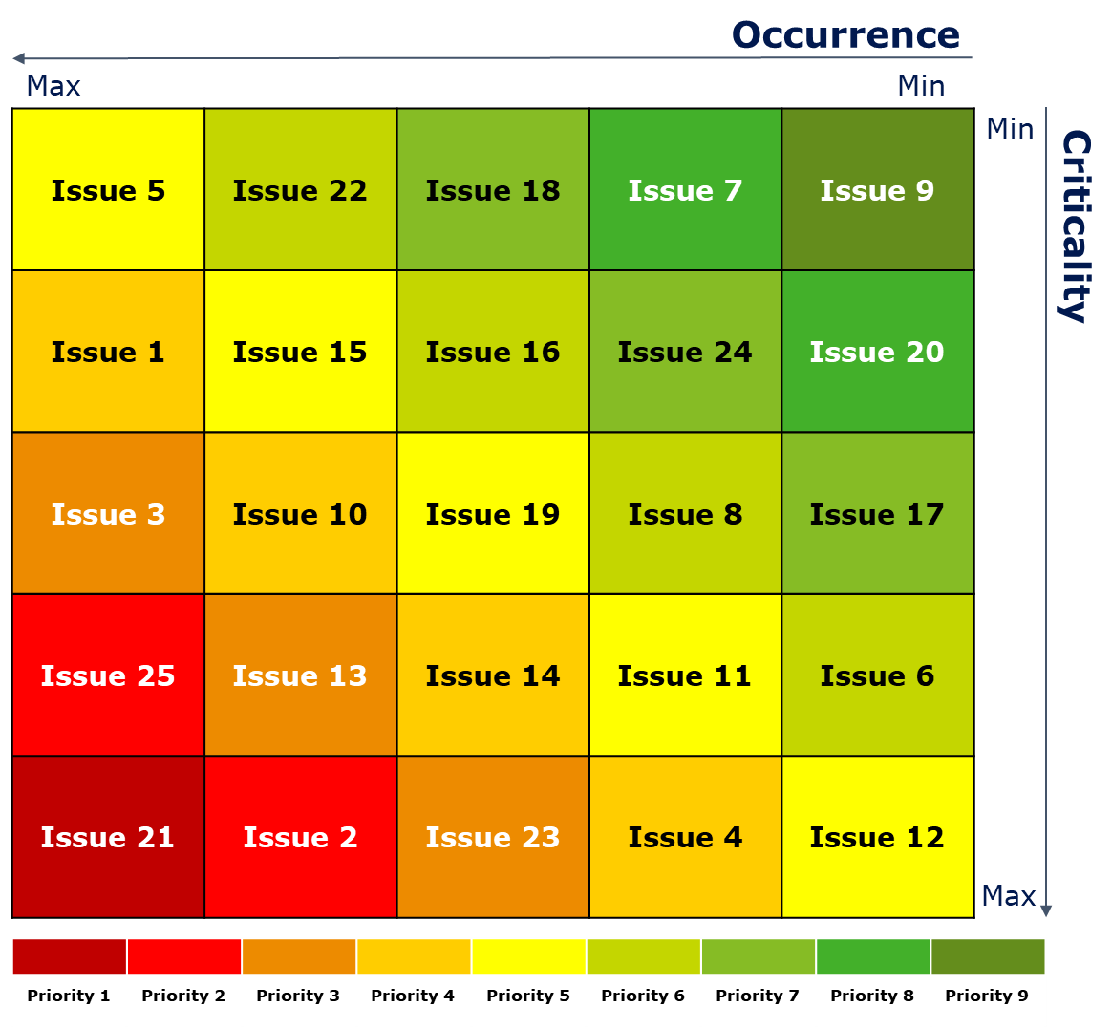
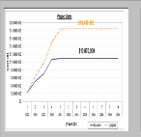
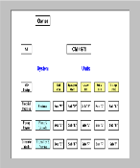
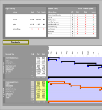

Module 4: Approach for Risk Management
1. Issue Identification
2. Issue Evaluation and Scoring
3. Risk Matrix and Issue Prioritization
Impacting Issues
There are a number of issues that have a manifold impact over the organization and business
Occurrence
An assessment on the probability of an event / risk occurring. A rating of defined scores across categories shall be used:-
Risk Assessment Score - After assessing the probability and impact, Risk score is determined by multiplying the probability rating by impact rating. This gives a score based on which these are Priority-categorized and put on a matrix and the ones with highest priority are taken care of first
Financial Issues
Cost Overrun
Low rate of return
Higher borrowing rate
Un-optimized spending
Level | Description
1 | Almost Certain
0.8 | Likely
0.6 | Possible
0.4 | Unlikely
0.2 | Rare
Resource
Constraints
Project Boundary
Project and O&M Issues
Illustrative
Project Finance
Un-optimized resource Planning
Reporting Issues
Payroll processing
Project Timelines/ Delivery
Supply Issues
Inventory lags
Vendor Management Issues
Business/ Organization
Criticality
The impact or consequences on the ERP implementation project if the event was to occur. Assuming the risk has materialized, assessment of impact in terms of: Cost, delays, security of data, and reputation and is rated with designated weighted scoring
Contract/ Commitment
Contractual Issues
Inappropriate contract terms
Non-binding contract
Lack of contract monitoring
Level | Description
5 | Critical
4 | High
3 | Medium
2 | Moderate
1 | Low
Issues Listing
We will critically assess and list the issues that creates an impact in CIL’s business and organization
Illustrative

